Slide 1
C++ : Object-Oriented Programming
Classes and Objects

Slide 2
C++ class
class class_name
{
access_specifier:
data and functions
...
access_specifier:
data and functions
...
} ;

Slide 3
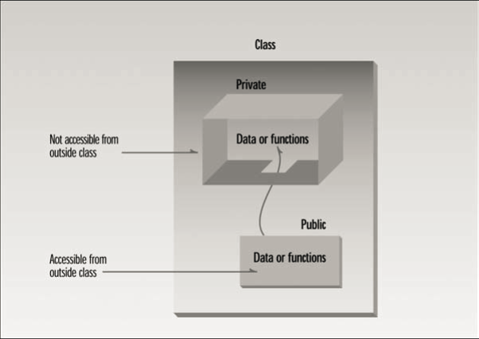
Private and public

Slide 4
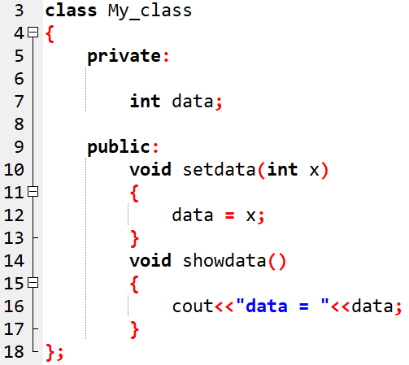
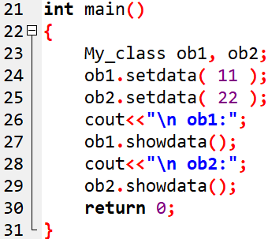

Class example-1
OUTPUT:

Slide 5
member function definition outside the class:
Syntax:
return_type class_name :: function_name( parameters )
{
function_body;
}

Slide 6
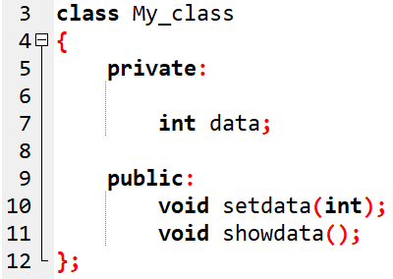
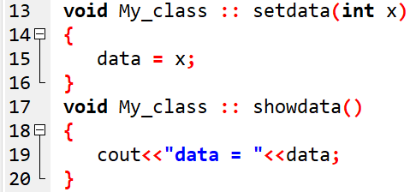

Slide 7
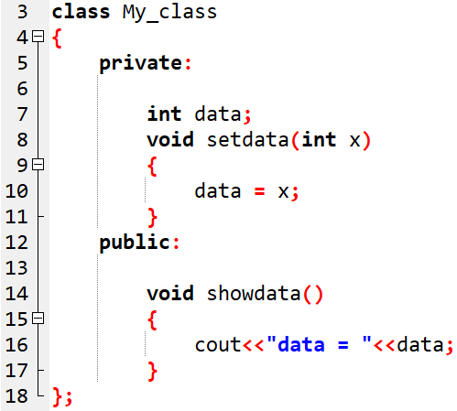
Class example-2
Error ! Setdata() is not accessible

Slide 8
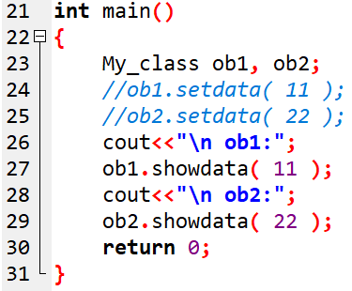
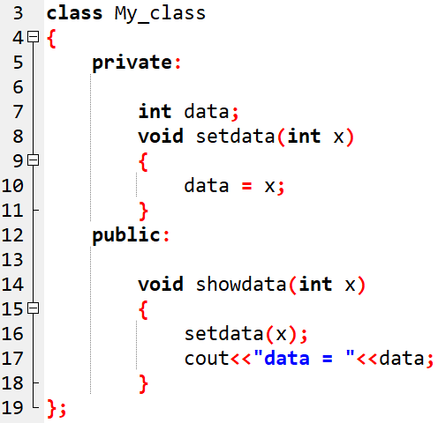

Class example-3
OUTPUT:

Slide 9
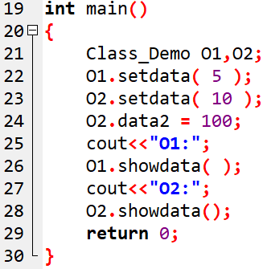
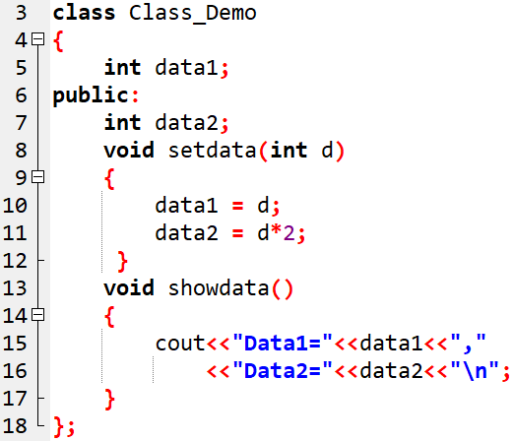

Class example-4
OUTPUT:

Slide 10
class Test
{
private:
int mark;
float cgpa;
public:
void SetData()
{
cin>>mark;
cin>>cgpa;
}
void DisplayData()
{
cout << "Mark= "<<mark;
cout << "cgpa= "<<cgpa;
}
} ;
int main()
{
Test o1,o2;
o1.SetData();
o1.DisplayData();
o2.SetData();
o2.DisplayData();
return 0;
}
mark = 50
o1
cgpa = 7.5
mark = 70
o2
cgpa = 6.83
Notes:
Executes statements and return to calling function

Slide 11
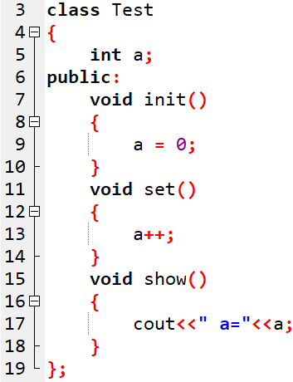
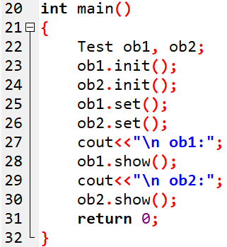

Question-1
OUTPUT:

Slide 12
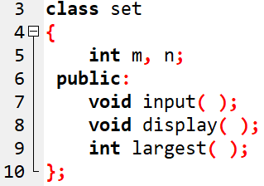
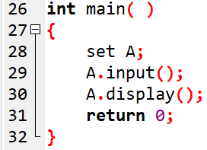
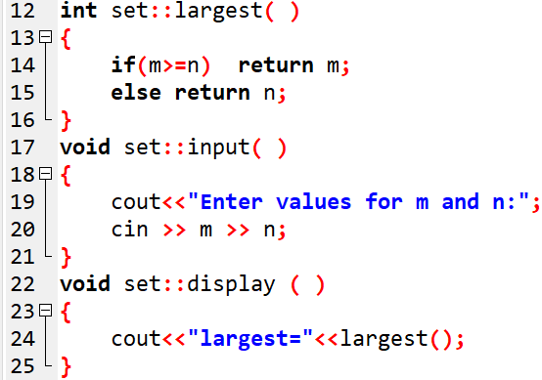

Class example-5: Nesting of member functions
OUTPUT:

Slide 13
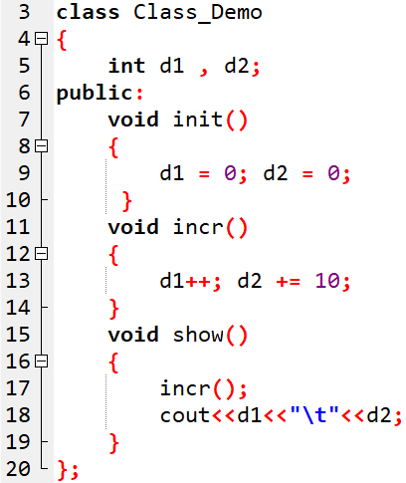
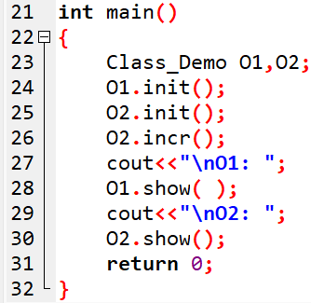

Question-2
OUTPUT:

Slide 14
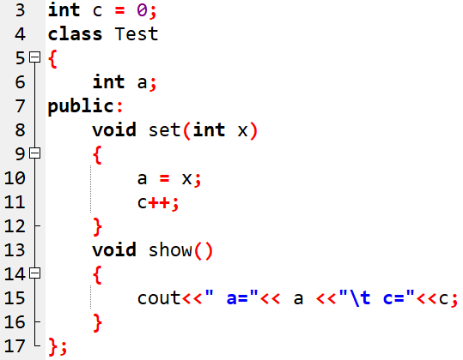
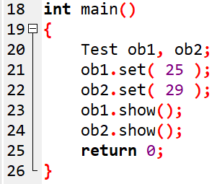

Question-3
OUTPUT:

Slide 15
Initialization and Constructors
The constructor is responsible for initializing objects automatically whenever they are declared.
The programmer has the option to provide his/her own constructors, which get called whenever a new object is declared.
Otherwise, the compiler provides a default constructor.

Slide 16
Constructors …
The constructor is like any other method (i.e., member function) in that,
  it takes arguments
  it can be overloaded
  its arguments can be defaulted
But with one big difference: It has no return value, not even void.
One other very important characteristic: the constructor’s name is the same as the class name.

Slide 17
Constructor
class car
{
private:
float mileage;
public:
void setdata()
{
mileage = 1;
}
};
class car
{
private:
float mileage;
public:
};
Same name as class name
Similar to member function
car()
{
mileage=1;
}
int main()
{
}
Called automatically on creation of object
int main()
{
}
car c1,c2;
car c1,c2;
car c1;
car c1;
c1.setdata();
c2.setdata();

Slide 18
Constructor
class Rectangle
{
int width,height;
public:
Rectangle(){
width=5;
height=6;
cout<<”Constructor Called”;
}
};
int main()
{
Rectangle r1;
return 0;
}

Slide 19
Types of Constructors
Default constructor
Parameterized constructor
Copy constructor

Slide 20
1) Default Constructor
Default constructor is the one which is invoked by default when object of the class is created.
It is generally used to initialize the default value of the data members.
It is also called no argument constructor.
class demo{
int m,n;
public:
demo()
{
m=n=10;
}
};
int main()
{
demo d1;
}
Object d1
m
n
10
10

Slide 21
Program Constructor
class Area
{
private:
int length, breadth;
public:
Area(){
length=5;
breadth=2;
}
void Calculate(){
cout<<"\narea="<<length * breadth;
}
};
int main(){
Area A1;
A1.Calculate();
Area A2;
A2.Calculate();
return 0;
}
A1
A2
length
breadth
length
breadth
5
2
5
2

Slide 22
2) Parameterized Constructor
Constructors that can take arguments are called parameterized constructors.
Sometimes it is necessary to initialize the various data elements of different objects with different values when they are created.
We can achieve this objective by passing arguments to the constructor function when the objects are created.

Slide 23
Parameterized Constructor
Constructors that can take arguments are called parameterized constructors.
class demo
{
int m,n;
public:
demo(int x,int y){ //Parameterized Constructor
m=x;
n=y;
cout<<“Constructor Called“;
}
};
int main()
{
demo d1(5,6);
}
d1
m
n
5
6

Slide 24
3) Copy Constructor
A copy constructor is used to declare and initialize an object from another object using an object as argument.
For example:
demo(demo &d); //declaration
demo d2(d1); //copy object
OR demo d2=d1; //copy object
Constructor which accepts a reference to its own class as a parameter is called copy constructor.
Notes:
These are special type of Constructors, and is used to copy values of data members of one object into other object.

Slide 25
Copy Constructor
class demo
{
int m, n;
public:
demo(int x,int y){
m=x;
n=y;
cout<<"Parameterized Constructor";
}
demo(demo &x){
m = x.m;
n = x.n;
cout<<"Copy Constructor";
}
};
int main()
{
demo obj1(5,6);
demo obj2(obj1);
demo obj2 = obj1;
}
obj1
obj1 or x
m
n
5
6
obj2
m
n
5
6

Slide 26
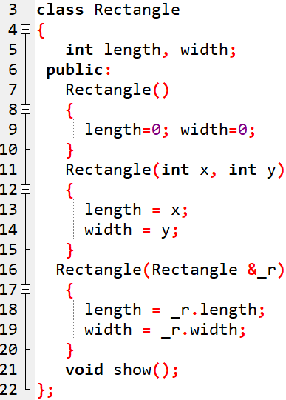
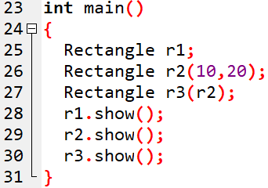

OUTPUT:

Slide 27
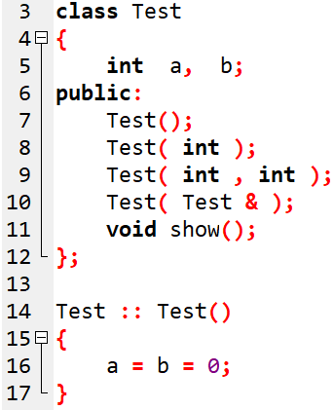
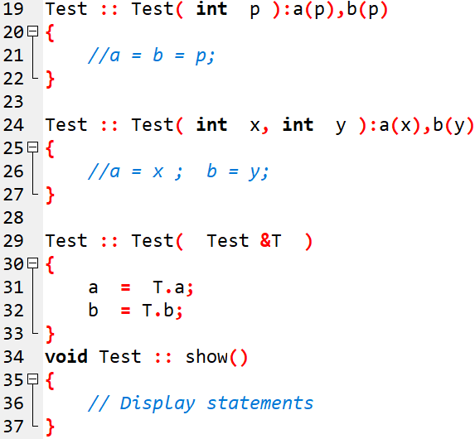

Slide 28
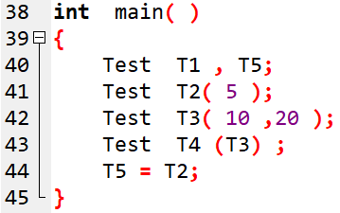

Slide 29
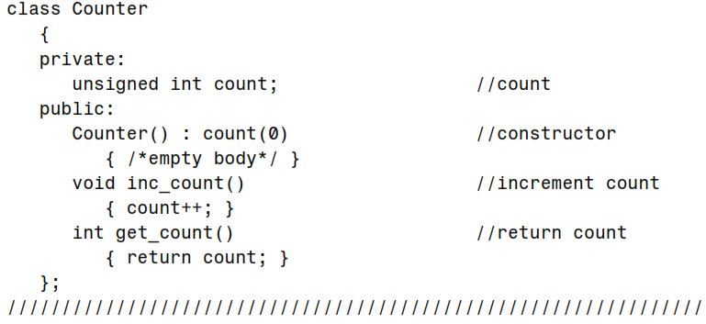
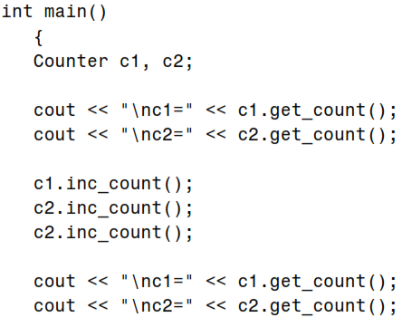
Note: If multiple members must be initialized, they’re separated by commas.

Slide 30
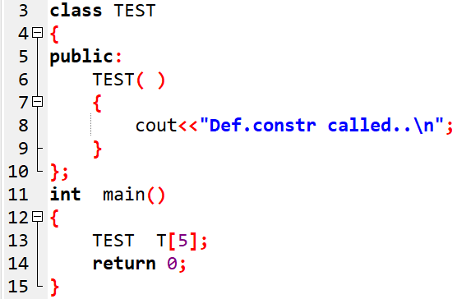
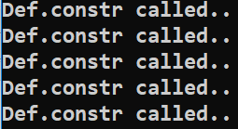
Example-3
OUTPUT:

Slide 31
Another way to initialize an object default copy constructor
We can initialize it with another object of the same type.
No need to create a special constructor for this; one is already built into all classes. It’s called the default copy constructor.
It’s a one argument constructor whose argument is an object of the same class as the constructor
Notes:
Deep and shallow copy constructor

Slide 32
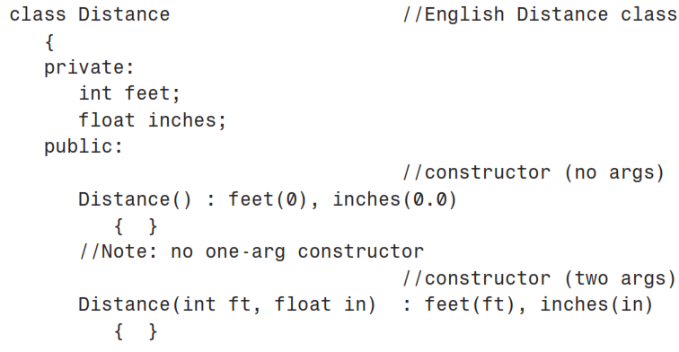
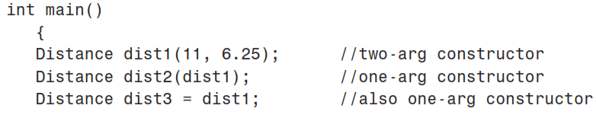
. . . . . . . . . . . .
Notes:
might think this would require us to define a one-argument constructor, but initializing an object with another object of the same type is a special case. This causes the default copy constructor for the Distance class to perform a member-by-member copy of dist1 into dist2.

Slide 33
Let’s mention another way to initialize an object: you can initialize it with another object of the same type.
Surprisingly, you don’t need to create a special constructor for this; one is already built into all classes. It’s called the default copy constructor.
It’s a oneargument constructor whose argument is an object of the same class as the constructor
We initialize dist1 to the value of 11’-6.25” using the two-argument constructor.
Then we define two more objects of type Distance, dist2 and dist3, initializing both to the value of dist1.
You might think this would require us to define a one-argument constructor, but initializing an object with another object of the same type is a special case.
These definitions both use the default copy constructor. The object dist2 is initialized in the statement Distance dist2(dist1);
This causes the default copy constructor for the Distance class to perform a member-by-member copy of dist1 into dist2.

Slide 34
Destructor
class car
{
float mileage;
public:
car(){
mileage=0;
}
~car(){
cout<<" destructor";
}
};
Destructor is used to destroy the objects that have been created by a constructor.
The syntax for destructor is same as that for the constructor,
  the class name is used for the name of destructor,
  with a tilde (~) sign as prefix to it.
Destructor
never takes any argument nor it returns any value nor it has return type.
is invoked automatically by the complier upon exit from the program.
should be declared in the public section.

Slide 35
Program: Destructor
class rectangle
{
int length, width;
public:
rectangle(){ //Constructor
length=0;
width=0;
cout<<”Constructor Called”;
}
~rectangle() //Destructor
{
cout<<”Destructor Called”;
}
// other functions for reading, writing and processing can be written here
};
int main()
{
rectangle x;
// default constructor is called
}

Slide 36
Program: Destructor
int main( )
{
Marks m1;
Marks m2;
return 0;
}
class Marks{
public:
int maths;
int science;
//constructor
Marks() {
cout << "Inside Constructor"<<endl;
cout << "C++ Object created"<<endl;
}
//Destructor
~Marks() {
cout << "Inside Destructor"<<endl;
cout << "C++ Object destructed"<<endl;
}
};

Slide 37
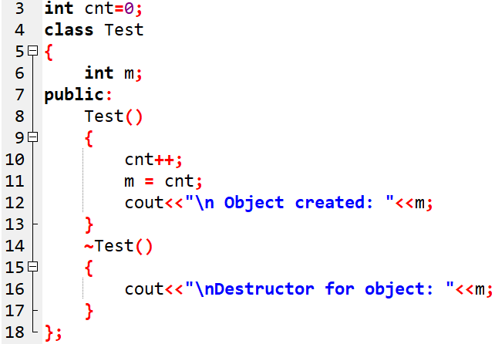
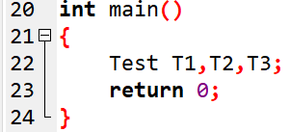
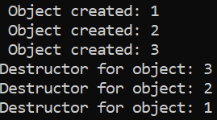
Destructor Example-2:

Slide 38
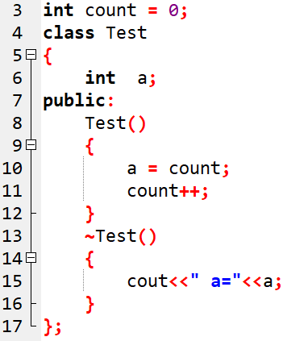
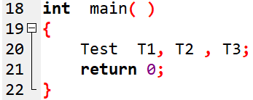
Question

Slide 39
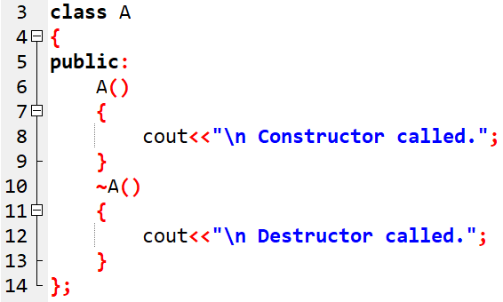
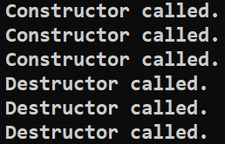
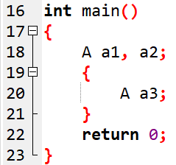
Question
OUTPUT:

Slide 40
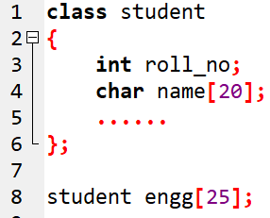
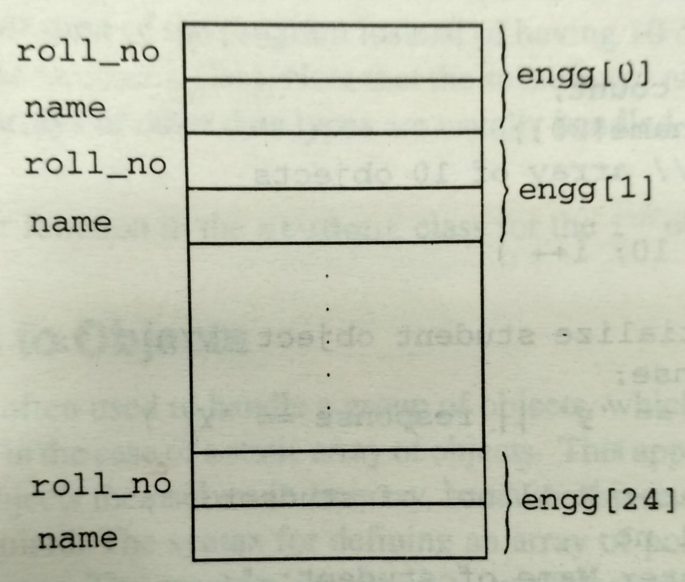
ARRAY OF OBJECTS

Slide 41
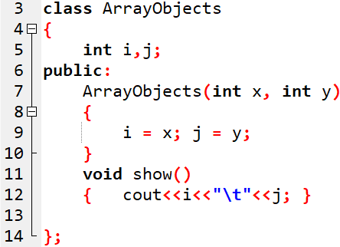

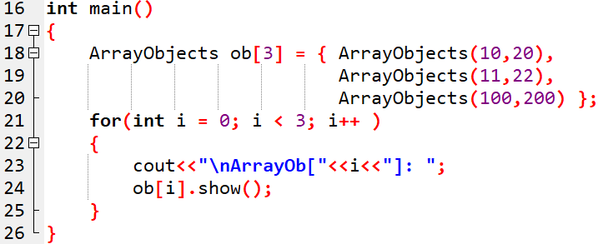
Array of objects:

Slide 42
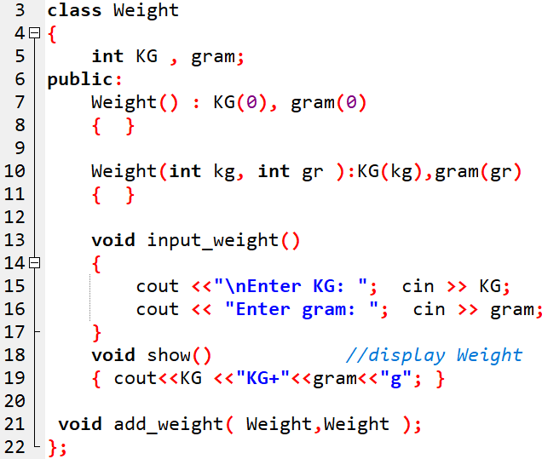
Example: Objects as function argument

Slide 43
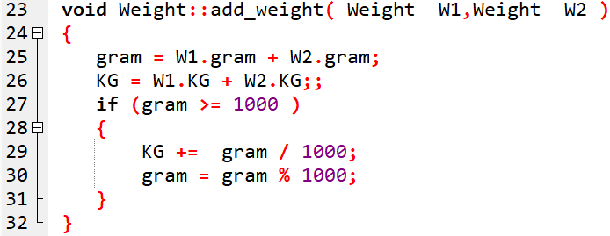
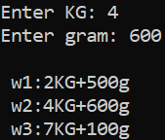
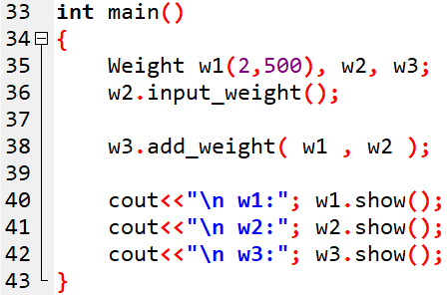

Slide 44
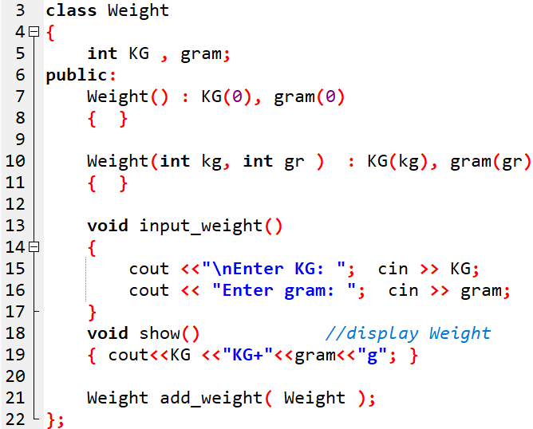
Example-: Returning an object

Slide 45
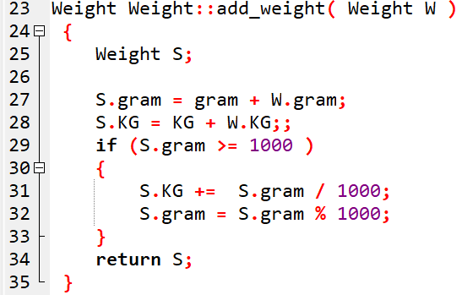
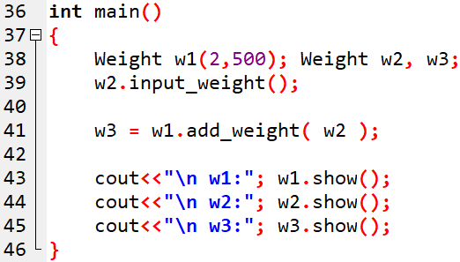

Slide 46
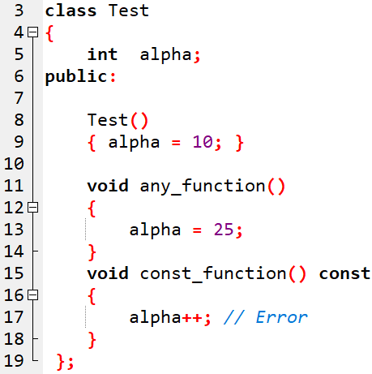

Constant member function
Notes:
A const member function guarantees that it will never modify any of its class’s member data.The idea of const functions is not to allow them to modify the object on which they are called. It is recommended practice to make as many functions const as possible so that accidental changes to objects are avoided.

Slide 47

Constant member function…

Slide 48


Constant objects
Notes:
Const object can only call CONST member function…An object declared as const cannot be modified and hence, can invoke only const member functions as these functions ensure not to modify the object. A const object can be created by prefixing the const keyword to the object declaration.

Slide 49

Constant member function argument
Notes:
The qualifier const tells the compiler that the function should not modify the argument. The compiler will generate an error when this condition is violated. This type of declaration is significant only when we pass arguments by reference or pointers.

Slide 50


Slide 51

Question-1:
Error !
Notes:
we can apply const to objects of classes. When an object is declared as const, you can’t modify it. It follows that you can
use only const member functions with it, because they’re the only ones that guarantee not to modify it.

Slide 52

Question-2: Will it compile?

Slide 53
Static Data members
A static data member is useful,
when all objects of the same class must share a common information.
Just write static keyword prefix to regular variable
It is initialized to zero when first object of class created
Only one copy is created for each object
Its life time is entire program
Notes:
to access the global num variable in the main class you need to use scope resolution operator (i.e. ::num).
Example
1
2
3
4
5
6
7
8
9
10
#include<iostream>
using namespace std;
int num = 30; // Initializing a global variable num
int main()
{
int num = 10; // Initializing the local variable num
cout << "Value of global num is " << ::num;
cout << "nValue of local num is " << num;
return 0;

Slide 54

;

Slide 55


Slide 56
Static Data members
class demo
{
static int count;
public:
void getcount()
{
cout<<"count="<<++count;
}
};
int demo::count;
int main()
{
demo d1,d2,d3;
d1.getcount();
d2.getcount();
d3.getcount();
return 0;
}
count
0
1
3
2
d1
d2
d3
Static members are declared inside the class and defined outside the class.

Slide 57
Regular Data members
class demo
{
int count;
public:
void getcount()
{
count = 0;
cout<<"count="<< ++count;
}
};
int demo::count;
int main()
{
demo d1,d2,d3;
d1.getcount();
d2.getcount();
d3.getcount();
return 0;
}
d1
d2
d3
1
1
0
0
1
0
count
count
count

Slide 58
Static Data Members
Data members of the class which are shared by all objects are known as static data members.
Only one copy of a static variable is maintained by the class and it is common for all objects.
Static members are declared inside the class and defined outside the class.
It is initialized to zero when the first object of its class is created.
you cannot initialize a static member variable inside the class declaration.
It is visible only within the class but its lifetime is the entire program.
Static members are generally used to maintain values common to the entire class.
Notes:
you cannot initialize a static member variable inside the class declaration. While defining the static variable, some initial value can also be assigned to the variable. Eg:- int item :: count=10;

Slide 59



Program : Static data member

Slide 60




Slide 61



OUTPUT

Slide 62
Static Member Functions

Slide 63
Static Member Functions
Static member functions can access only static members of the class.
Static member functions can be invoked using class name, not object.
There cannot be static and non-static version of the same function.
A static member function does not have this pointer.

Slide 64


OUTPUT

Slide 65


Slide 66


Question:
Create Emp class with data members for storing emp id , age , salary.
ID is static.

Slide 67

solution

Slide 68
Friend function
A friend function is not in the scope of the class, in which it has been declared as friend.
It cannot be called using the object of that class.
It can be invoked like a normal function without any object.
Unlike member functions, it cannot use the member names directly.
It can be declared in public or private part without affecting its meaning.
Usually, it has objects as arguments.

Slide 69



Example1: Friend function
Output

Slide 70





// Forward reference
Example 2: Friend function with two classes
// First class
// Second class

Slide 71


Question: Replace member function by friend function

Slide 72



Solution.

Slide 73

Question: Define the friend function

Slide 74

Solution:

Slide 75



